Slide 1

Research Paper
Group 2 -
Harshitha Mohanraj Radhika
Janani Ravikumar
Hieu Tran

Slide 2
TITLE
NoSQL databases - Unstructured data into Structured data

Slide 3
Introduction
Massive growth in Internet usage, a large amount of data is being produced and accessed by various organizations.
Many researchers have proven that over 95% of the digital universe contains unstructured data [1].
Data collection techniques from various sources have increased rapidly as the information generated and stored increases exponentially with each passing day. The growth of collected data is also exponential.
The variety of data (unstructured, semi-structured, structured) is still a problem that needs to be solved.
No generic approach to convert unstructured data to structured data.

Slide 4
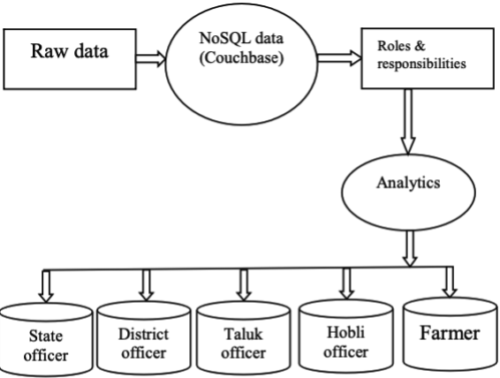
Previous Work
Converting unstructured data into semi-structured or structured data using the NoSQL tool Couchbase:
Couchbase is an open-source distributed NoSQL database engine. It is designed to easily build modern applications with flexible data models, high availability, high performance, high scalability, and advanced security.

Slide 5
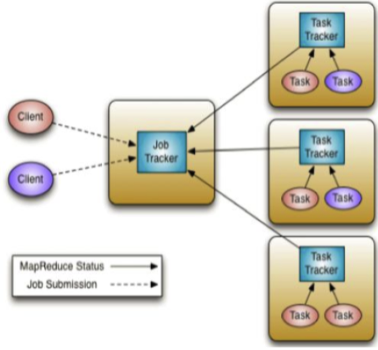
Previous Work (Cont’d)
Transforming unstructured data to structured data using Hadoop ecosystem:
Hadoop ecosystem is a framework used to reduce big data organization problems.
A MapReduce job mostly separates the data information into self-managed chunks, which are processed by the map jobs entirely in parallel.
It consists of a single master node, namely the JobTracker, and many slave nodes, namely the TaskTrackers.

Slide 6
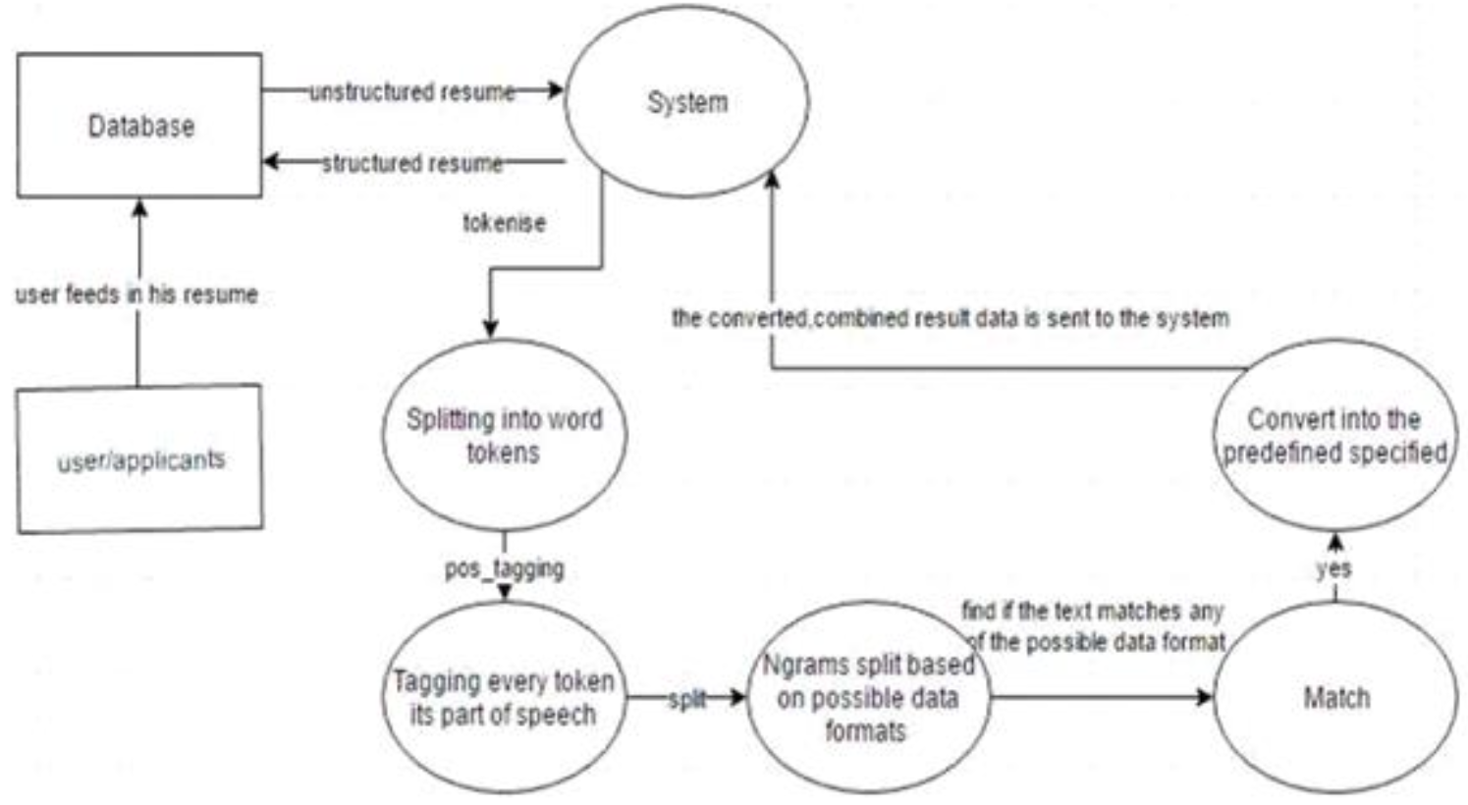
Previous Work (Cont’d)
Conversion of unstructured data to structured data with a profile handling application:
Converting unstructured data into a structured format is essentially dealt with Data Mining and Natural Processing Language (NLP).
In 1998, Merrill Lynch cited a rule of thumb that somewhere around 80- 90% of all potentially usable business information may originate in the unstructured form [2].
The conversion from unstructured data to structured data has three main states: a database containing unstructured data, data in its intermediate state, and successfully structured data.

Slide 7

State of the art
UNSTRUCTURED DATA:
Unstructured data is one which does not have a predefined model and has been used over the past several years. It does not have a predefined structure and thus cannot fit into relational tables.
These data are generated from two forms either humans or machines. Unstructured information is typically text-heavy, but may contain data such as dates, numbers, and facts as well.
Data from the media, email, websites, communication data etc. are the human generated data.
Satellite data or images, digital surveillance data, scientific data are machine generated variety of unstructured data. The data can be either textual or non textual data.
Unstructured data can also have internal structural elements.

Slide 8
State of the art(cont’d)
EXTRACTING UNSTRUCTURED DATA:
The initial step to extract the data is to analyze the data sources.
We should also be clear with what insights or results we need from the analysis.
We need to finalize the kind of technology we are going to work to intake the data and store as per the business needs.
The information must be stored in a place to be analysed.
Data must be formulated for storage.They require a large storage and are usually stored in data lakes.

Slide 9
State of the art(cont’d)
CURRENT STATE OF ART
The unstructured data can be processed using spark built-in functions or create our own functions to transform the unstructured data into a structural form. In this modern world of big data, there is ample unstructured data.
Unstructured data could be anything: media, imaging, audio, sensor data, text data, and much more. Its datasets aren’t stored in a structured database format. This kind of data has an internal structure, but it’s not predefined through data models.
Apache Spark is a general-purpose computing engine which is 100 times faster than Apache Hadoop. It has a set of libraries for parallel data processing and also converts unstructured data into knowledge.
Spark can be used for interactive queries. Using spark, we can convert the unstructured data to either RDD or a dataframe which makes the data structured. Spark is used for writing big data applications to support a wide range of data analytics tasks efficiently using optimization.

Slide 10
State of art (cont’d)
SPARK ARCHITECTURE:
A Spark master JVM is like the cluster manager in a standalone deployment mode. A Spark driver distributes Spark tasks to each executor and receives computed results from each executor’s tasks. Spark executors execute the tasks, store and cache data partitions in their memory.
SparkSession is the entry point for Spark application for extracting or reading the data, working with metadata, and cluster resource management. A Spark job has a set of transformations triggered by an individual action.
RDDs are the foundation of Apache Spark and are schema-less data structures. RDD is split into chunks based on key and are distributed to executor nodes and are operated in parallel. Using spark the unstructured data is converted into RDDS which are further converted into data frames which have a schema and thus become a structured data.
DataFrames are built upon RDDs. DataFrame is distributed collection of data organized into named columns. The text files are the frequent unstructured data which is converted to structured data using spark.

Slide 11
Recent work
PySpark is a data analytics tool created by Apache Spark Community for using Python along with Spark. It allows us to work with RDD (Resilient Distributed Dataset) and DataFrames in Python.
PySpark has numerous features that make it such an amazing framework and when it comes to deal with the huge amount of data. PySpark provides us flexibility, in-memory computation, and various other features.
PySpark DataFrame is a distributed collection of data in rows under named columns. In simple terms, we can say that it is same as a table in a Relational database or an Excel sheet with Column headers.

Slide 12
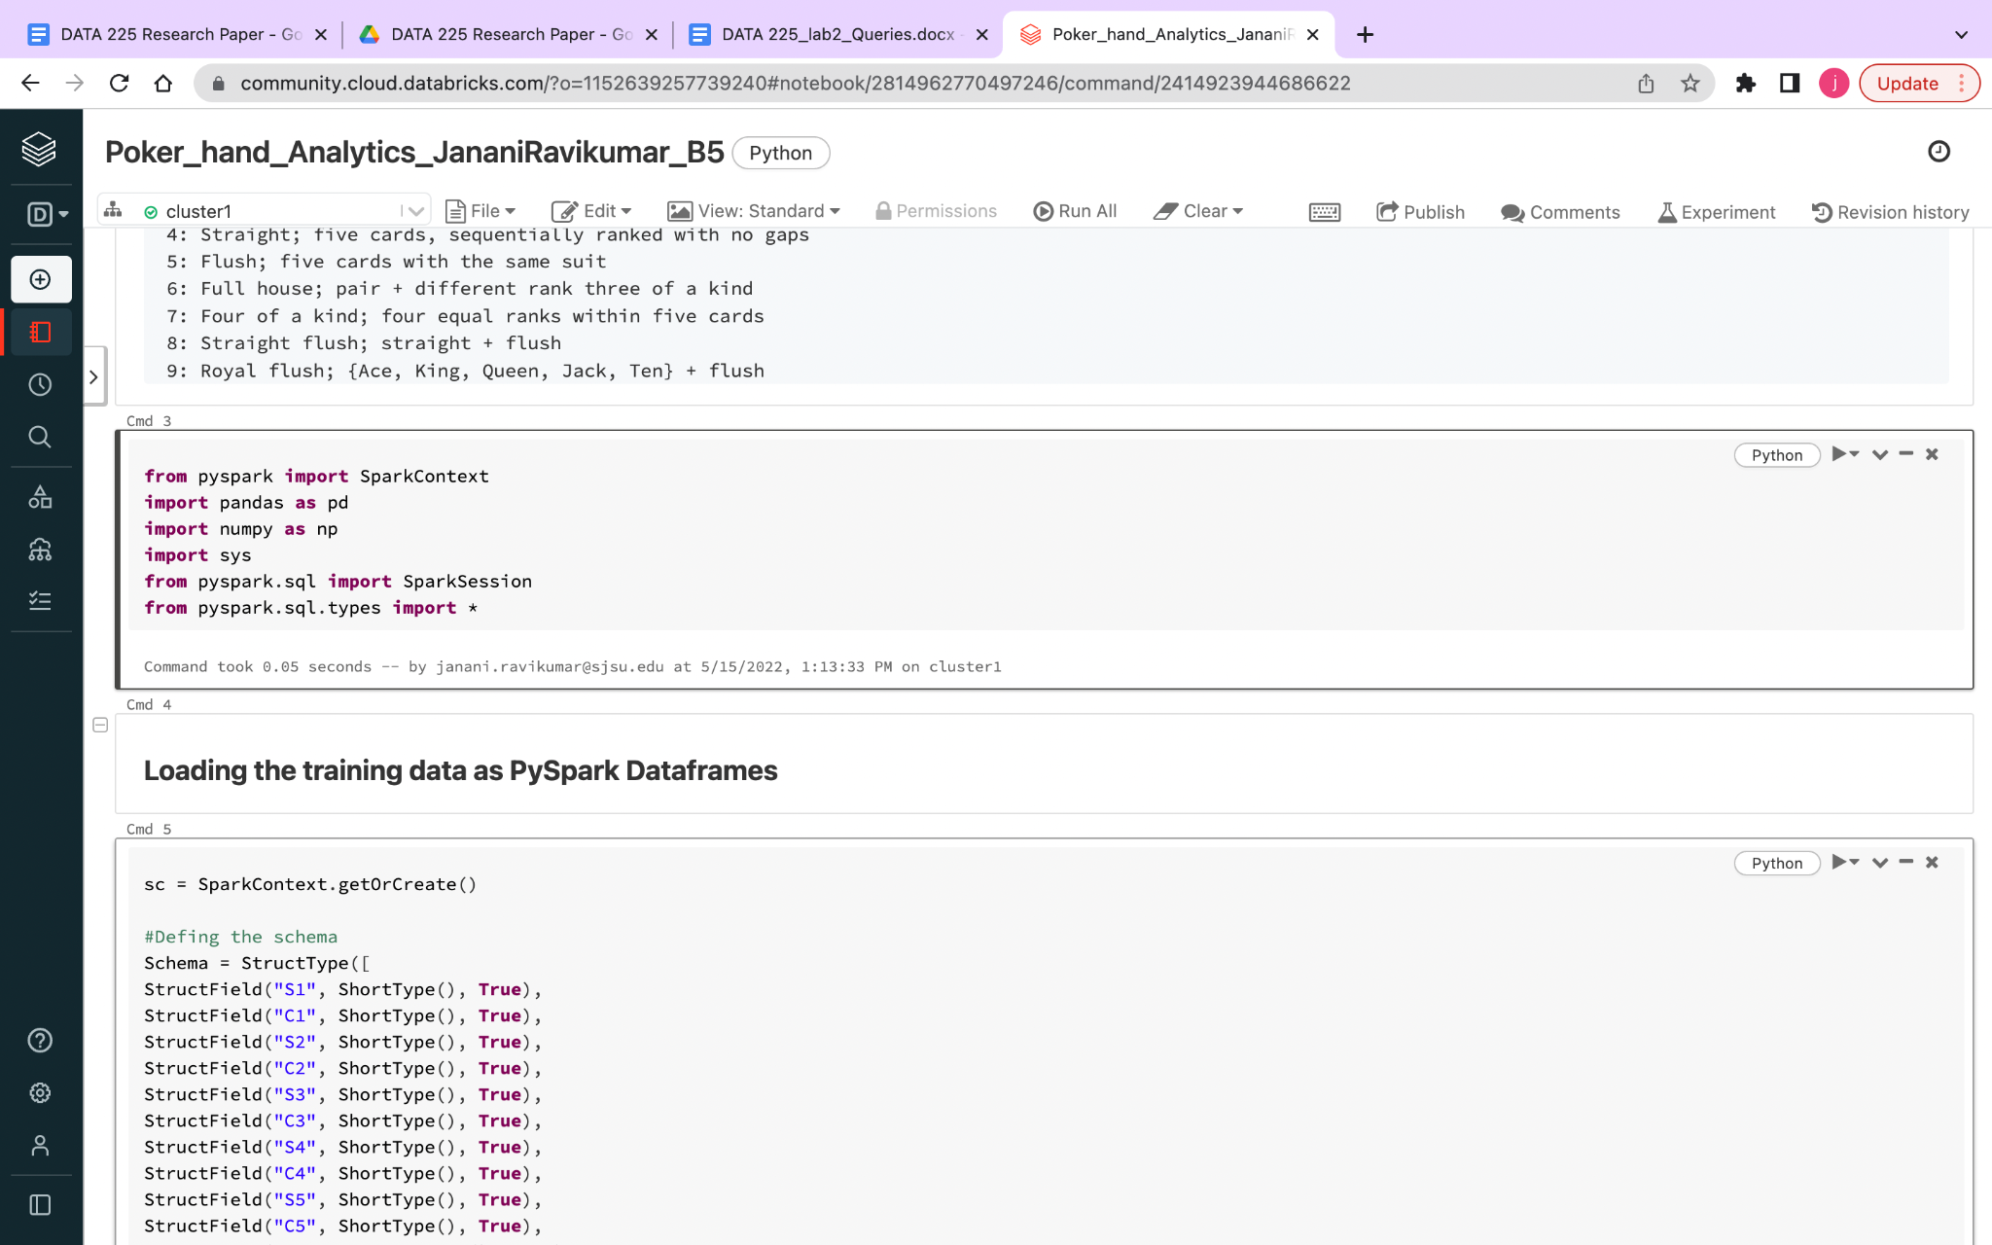
Example
Let’s consider a poker dataset which is stored as text file and is a unstructured data that cannot be into fit into relational tables
The import function PySpark. sql. types provide with the Type of data that needs to be imported and defines the data type. PySpark SQL is a module in Spark which integrates relational processing with Spark's functional programming API.

Slide 13
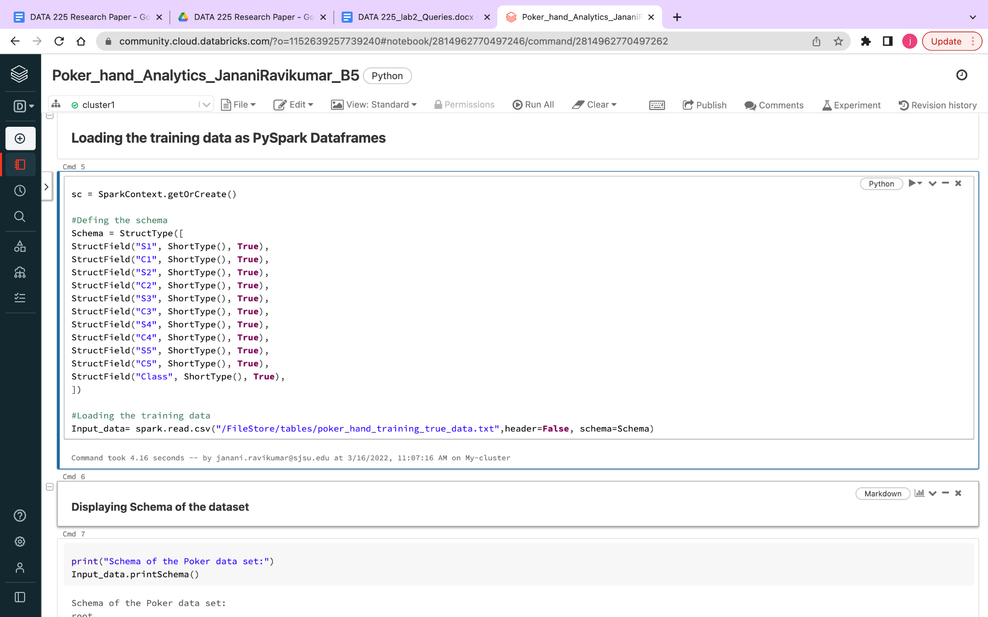
Example(cont’d)
Loading the data
There are three ways to read text files into PySpark DataFrame using spark.read.text(),spark.read.csv() and spark.read.format().load(). Here Input_data returns the schema of this DataFrame .

Slide 14
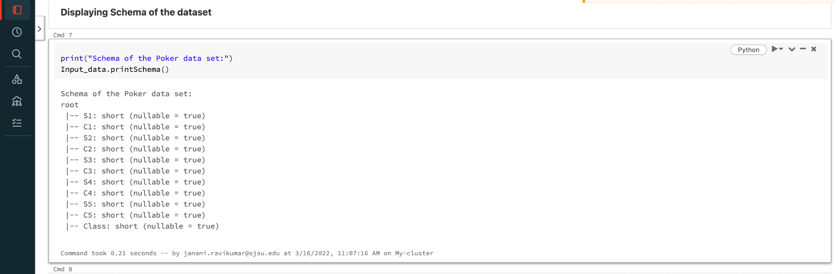
Example(cont’d)
The schema of the data will look like this

Slide 15
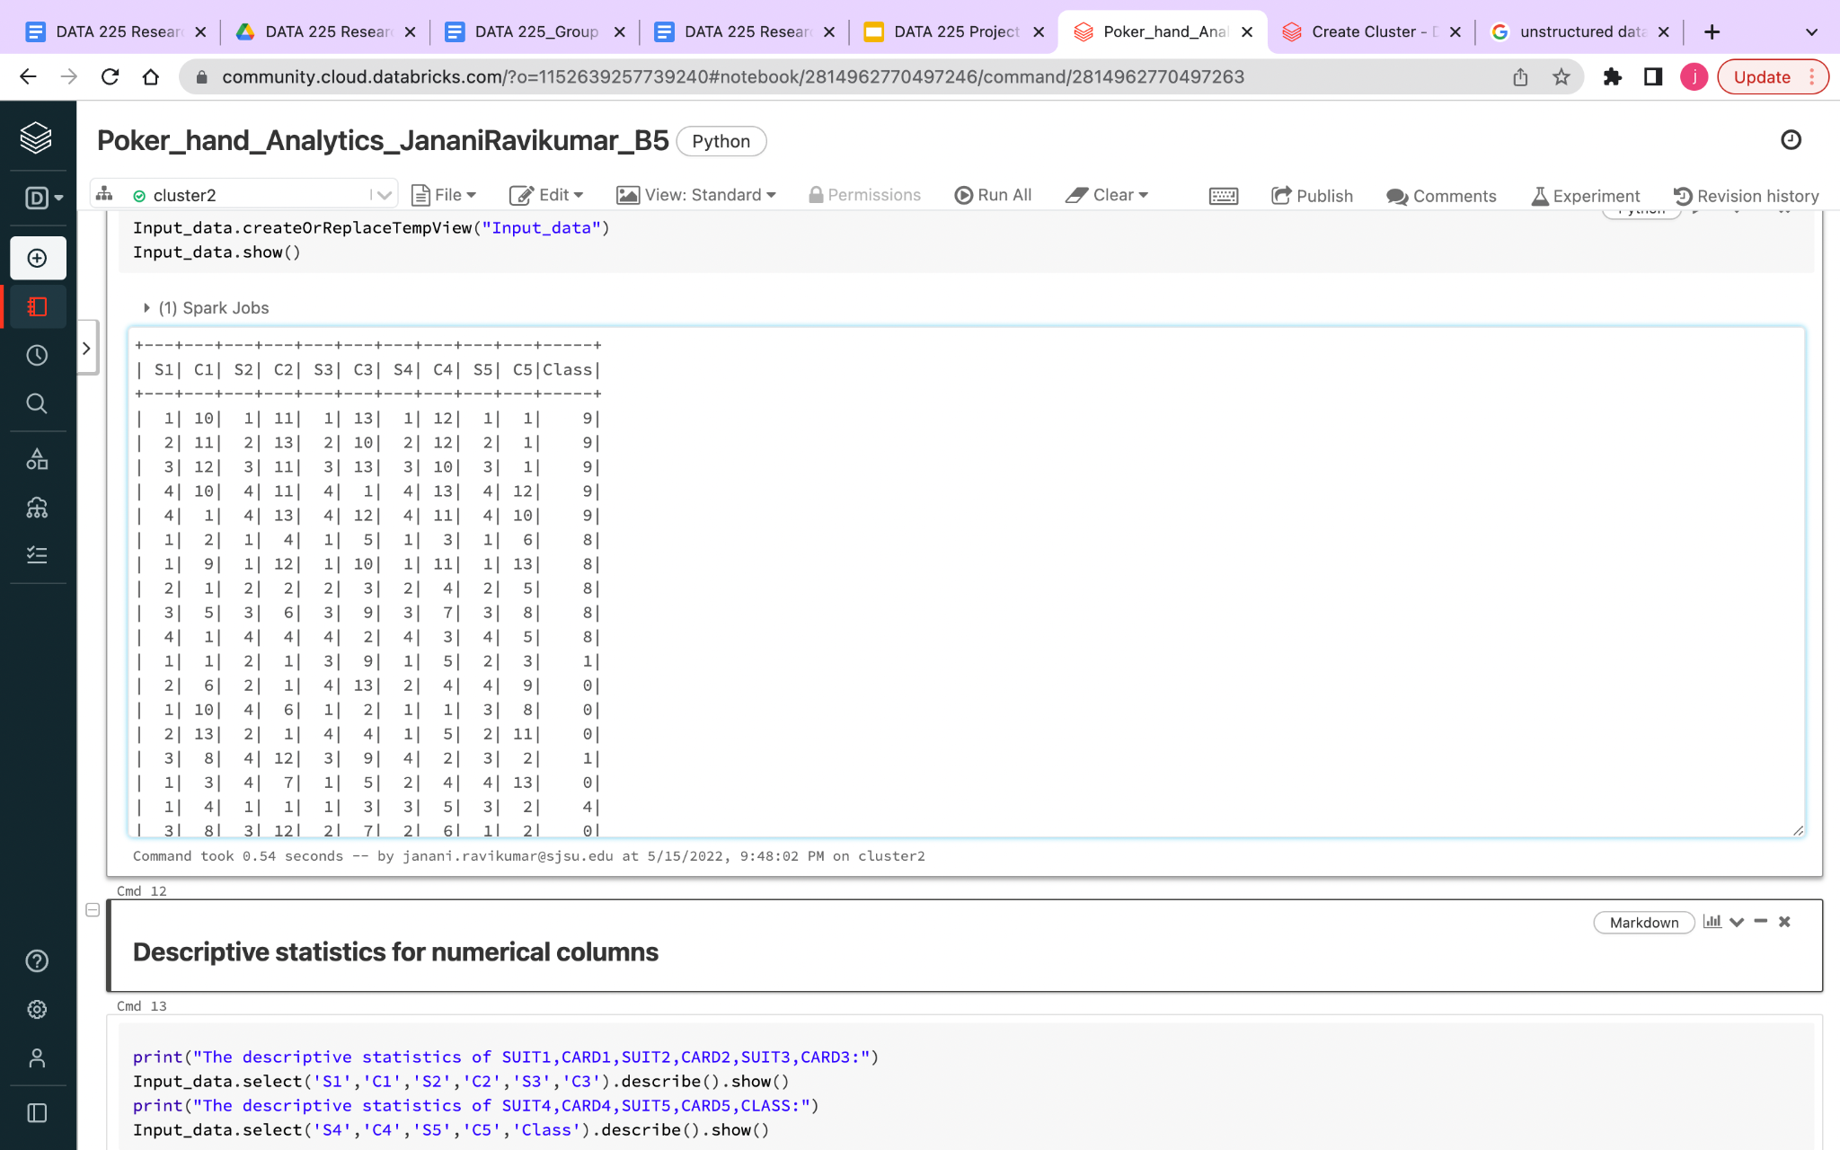
Example(cont’d)
A temporary view can be created to view the dataframe

Slide 16
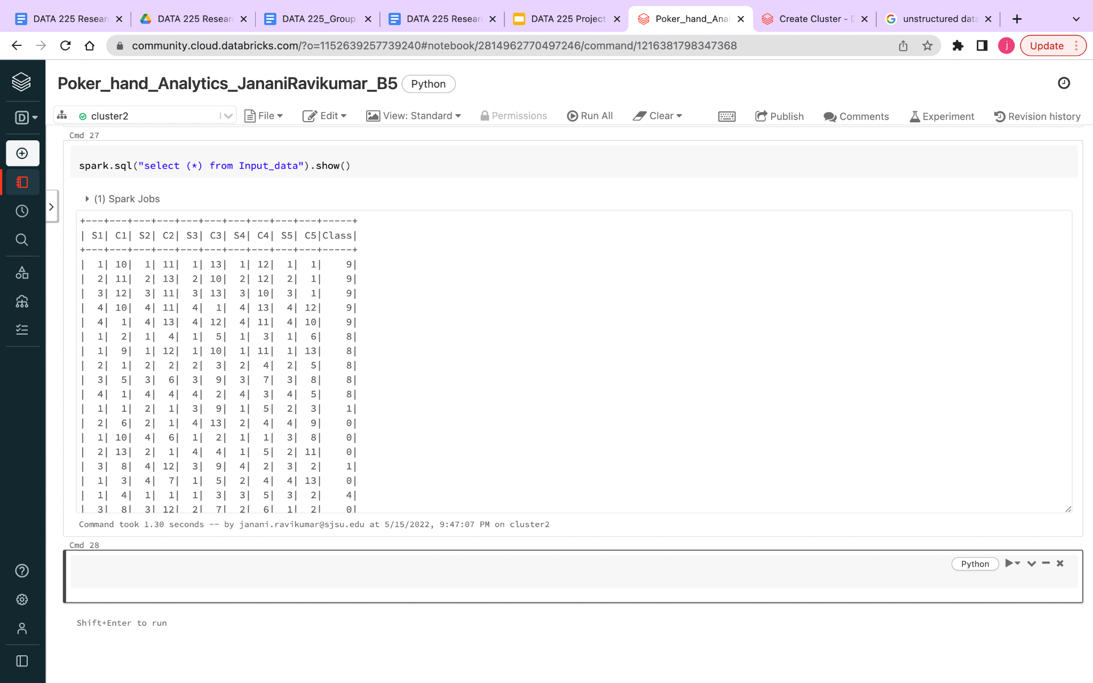
Example(cont’d)
Querying the dataset and generating useful insights from the data

Slide 17
Limitations of spark
1.No File Management system
2.No Support for Real-Time Processing
3.Latency
4.Less number of Algorithms
5.Inability to have concurrent users
6.Iterative Processing
7.Small File Issue

Slide 18

Future Plan
A. Original list of potential research topics
Spark Streaming in Real time Data:
Spark streaming is an extension of Spark which can stream live data in real-time from web sources.
Spark has its own SQL engine and works well when integrated with Kafka and Flume.
Examples - Uber, Pinterest
Natural Language Processing Data:
Text analysis machine learning programs use natural language processing algorithms to break down unstructured text data to structured.
It includes data preparation techniques like tokenization, part-of-speech tagging that transform unstructured text into a format that can be understood by machines for processing.
For the conversion of unstructured data to structured data, a number of machine learning algorithms can be used such as KNN, SVM, Random Forest, and Decision Tree can be used.

Slide 19
Future Plan (Cont’d)
Screening process:
Data cleanup is the first step before converting the unstructured data to structured.
To reduce redundancy and other issues raise in data cleanup, we create standard rules by making a list of rules about the way data has to be entered
Remove irrelevant data, filter out data outliers, deal with missing data and remove duplicates.
Frame a structure and metadata that is required to store the converted unstructured data.
Hive is not designed for the OLTP (Online transaction processing). We can use it for OLAP.
Hive does not provide insert and update at row level and so it is not suitable for OLTP system.

Slide 20
Future Plan (Cont’d)
Research plan
CONVERTING TO STRUCTURED DATA USING HIVE:
Apache Hive can read the input as unstructured data, process the data as needed, and then load the data into a relational data warehouse for decision support systems.
In this approach, data is extracted from the source for data processing and then stored in adaptable storage, such as Azure Storage blobs or Azure Data Lake Storage.
The data from the source is then transformed using a sequence of Hive queries.
Hive is the replica of relational management tables. It loads the unstructured data from HDFS, creates a structure around it, and loads back the converted structured data.

Slide 21
Future Plan (Cont’d)
HIVE ARCHITECTURE:
Apache Hive is an open-source data warehousing tool built on top of hadoop for performing distributed processing and data analysis.
It was developed by Facebook to reduce the work of writing the Java MapReduce program.
Hive Query language is used by Apache Hive, which is a declarative language similar to SQL.
Hive translates the hive queries into MapReduce programs and supports developers to perform processing and analyses on structured and semi-structured data by replacing complex java MapReduce programs by using hive queries.
The Beeline is a command shell supported by HiveServer, where the user can submit the queries and command to the system.
HiveServer2 is the successor of HiveServer1 in the architecture. HiveServer2 enables clients to execute queries against the Hive and allows multiple clients to submit requests and retrieve the final results.

Slide 22
Future Plan (Cont’d)
HIVE DATA PROCESS:
Hive uses the SerDe interface for IO operations. Different SerDe interfaces can read and write any type of data.
‘SerDe’ in hive stands for Serializer and Deserializer.
When an object is converted into a byte stream, that is into a binary format so that the object can be transmitted over a network or written into persistent storage like HDFS. This process of converting data objects into byte streams is called Serialization.
The process of converting byte stream or binary data back into objects is called Deserialization.
Hive provides us with a few built-in SerDe and using this built-in SerDe, data can be loaded into Hive.
Considering a Json file which is semi-structured, we will be using built-in JsonSerDe to load data into Hive. This JsonSerDe can be used to read data in JSON format. We will need to add JsonSerDe.jar to Hive.

Slide 23
Future Plan (Cont’d)
LOAD UNSTRUCTURED DATA:
To load unstructured data into Hive, RegexSerde can be used. Copy dataset from local file system to docker container
docker filepath
To load data into Hive table, we need dataset to be loaded into HDFS. As we are running HDFS and Hive in the docker container, we will need to copy this dataset from the Local File System to the docker container.
Copy dataset from a docker container to HDFS file system.
hdfs dfs -put /filepath
Create a Hive table
To load data into Hive and define the structure to our data, we must create a table in Hive before loading the data. The table holds the data in an organized manner. The Regex SerDe uses a regular expression (regex) to deserialize data by extracting regex groups into table columns.

Slide 24
Future Plan (Cont’d)
COMPARISON OF SPARK AND HIVE PERFORMANCE:
Spark is highly expensive in terms of memory than Hive due to its in-memory processing which in turn will increase the hardware costs for performing the analysis.
However, we cannot consider either of the tools as the replacement of the other. The selection of the tool must be as per the specifications and requirements considering the operating systems, database models, languages, and number of clients accessing the database concurrently.
The application that allows more number of users to access at same time it is proved that Hive has better performance.
We also use Bucketing in hive, concept of breaking data down into ranges, which are known as buckets, to give extra structure to the data so it may be used for more efficient queries.
The range for a bucket is determined by the hash value of one or more columns in the dataset that reduces time consumption.

Slide 25
References
[1] K.V.Kanimozhi1, Dr.M.Venkatesan “Unstructured Data Analysis- A Survey” Vol. 4, Issue 3, March 2015.
[2] Grimes, Seth. A Brief History of Text Analytics. B Eye Network. Retrieved June 24, 2016.
[3] Grimes, Seth. A Brief History of Text Analytics. B Eye Network. Retrieved June 24, 2016.
[4] K. Balakrishna, Smt. S. Jessica Saritha, C. Penchalaiah “Extracting Structue Data From UnStructured Data Through HiveQL”
[5] Rajesh Kumar Pallamala “An Investigative Testing of Structured and Unstructured Data Formats in Big Data Application Using Apache Spark” January 2022
[6] Robert Blumberg and Shaku Atre “The Problem with Unstructured Data”

Slide 26

Thank you!

